Slide 1


CSE240
Introduction to Programming Languages
Chapter 4
Functional Language Scheme
Lecture 21
Scheme Programming
Reading: Textbook Sections 4.4 and 4.5
Dr. Yinong Chen

Slide 2
Outline
Functional Programming Paradigm
Terminology
Some basic scheme procedures
Order of Execution
Define your own procedures -- procedure definition
Scopes: global environment and local names
Let forms and unnamed procedures
Recursion
Programming with data structure
Numbers, character, string, symbols, pairs and lists
Higher order functions
Modules and their interfaces

Slide 3
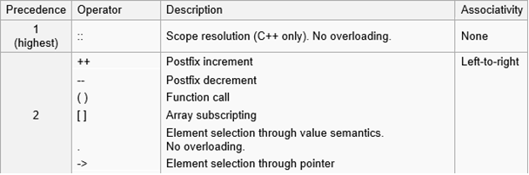
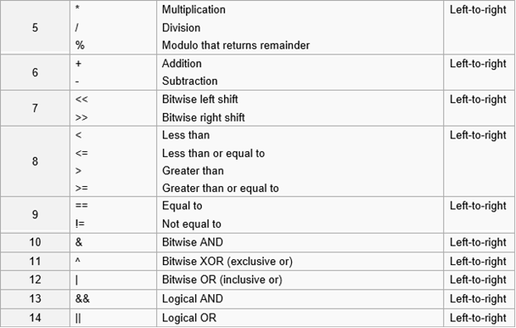
Order of Evaluation in C/C++: Text Section 2.2.1
For C/C++, at the same level of precedence:
a+b+c+d
(a+b)+(c+d)?
For Scheme, at the same level of precedence, the order does not matter

Slide 4
Order of Evaluation and Parallel Computing
Definition (Textbook, Section 4.3):
Eager evaluation: Evaluate everything that can be evaluated.
Innermost first;
Evaluate all arguments of a procedure first.
Lazy evaluation: Evaluate only those that are needed.
Outermost first;
Evaluate arguments of a procedure only if their values are needed.
Imperative programming requires of using lazy evaluation only. Functional programs guarantee that the same result will be produced no matter what order is used. It is more friendly for parallel computing
Example 1:
(+ (+ 3 5) (* (+ 4 6) (- 5 3)))
(1) (+ 4 6), (- 5 3), (+ 3 5),
(* 10 2), (+ 8 20)
(2) (+ 3 5), (+ 4 6), (- 5 3),
(* 10 2), (+ 8 20)
Example 2: (if c(x) a(y) b(z))
c, a, b, if
c, if, a; or c, if, b;
Which is better for parallel computing?
Assuming computing a, b, and c takes one hour each

Slide 5
Define a Procedure (absolute value)
(1) Define the absolute(x) procedure.
(define absolute
(lambda (x)
(if (negative? x)
(- x)
x
)
)
)
(absolute -5) (absolute 8) (absolute 0)
→ 5 → 8 → 0
Shorthand definition
(define (absolute x)
(if (negative? x)
(- x)
x
)
)
Unnamed procedure or Anonymous procedure

Slide 6
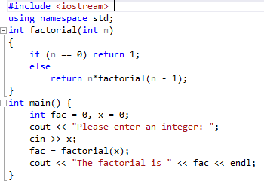
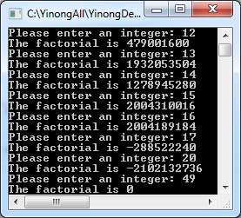
Define a Recursive Procedure in C++
1 if n = 0
n * factorial(n - 1) if n > 0
factorial(n) =
Size-n problem
Stopping condition and return value
Step 4
Size-n-1 problem

Slide 7
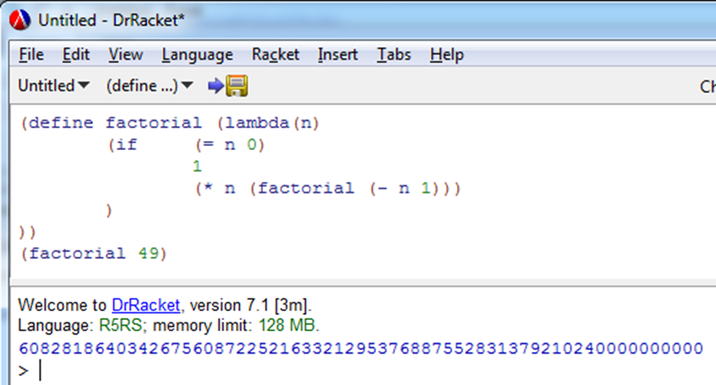
Define a Recursive Procedure in Scheme
1 if n = 0
n * factorial(n - 1) if n > 0
factorial(n) =
Size-n problem
Stopping condition and return value
(define factorial (lambda (x)
(if (= x 0)
1
(* x (factorial (- x 1)))
)
))
(factorial 49)
Step 4
Size-n-1 problem

Slide 8
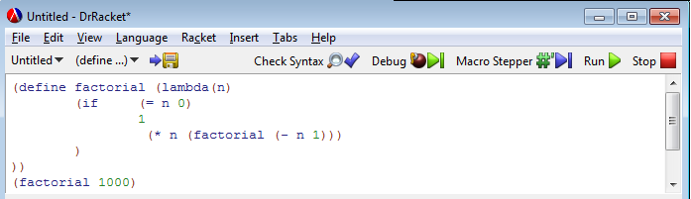
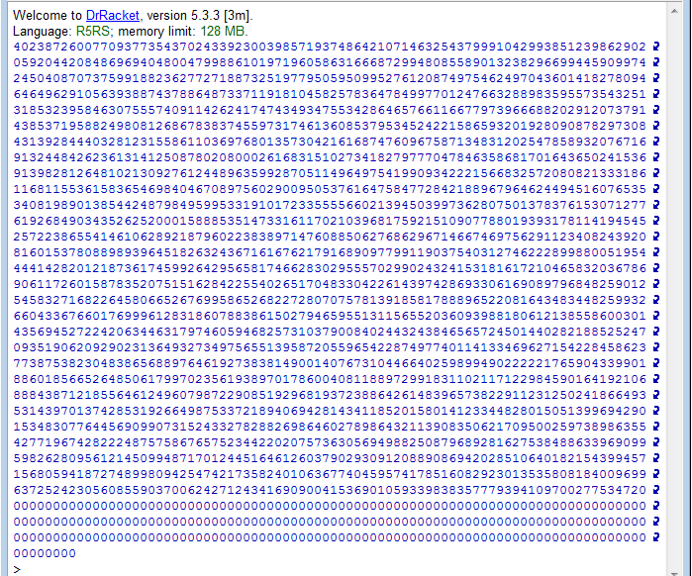
No overflow in Scheme, because math number does not overflow!
A list is used to represent a number.

Slide 9
A Procedure Calling Another Procedure
1 if n = 0
n * factorial(n - 1) if n > 0
factorial(n) =
(define factorial (lambda (x)
(if (= x 0)
1
(* x (factorial (- x 1)))
)))
(factorial 7) → 5040
(define multiply (lambda (x y)
(* x y)
))
(define factorial (lambda(n)
(if(= n 0) 1
(multiply n (factorial (- n 1)))
)))
(multiply 3 5) → 15
(factorial 7) → 5040

Slide 10
Define a Procedure (multi-conditional)
(define grades (lambda(n) (cond ((>= n 90) 'A) ((>= n 80) 'B) ((>= n 70) 'C) ((>= n 60) 'D) (else 'E) ; or use (true 'E) )
))
(grades 90) --> A (grades 81) --> B (grades 75) --> C (grades 62) --> D (grades 59) --> E

Slide 11
Case Study ABS (Anti-lock Braking System) and ASR (Acceleration Slip Regulation – Traction Control)
Requirement:
To obtain the maximum braking and traction effect
Algorithm:
Define (or measure) the wheel diameter;
Measure the wheel rotations per seconds rps;
Compute the wheel-generated velocity wv;
Measure the body velocity bv;
Error detection and action:
if (bv > wv), reduce braking force
else if (bv < wv), reduce acceleration force
else "no action"
ABS
Traction control

Slide 12
Implementing an ABS/ASR in C++
in a functional style
#include <iostream>
using namespace std;
const float mile_inch = 63360;
const float mypi = 3.14159;
float wheel_diameter = 15; // inches
float wheel_sensor() {
float rps;
cout << "get rotations per second: " << endl;
cin >> rps; // or from a sensor
return rps;
}

Slide 13
Implementing an ABS/ASR in C++ (contd.)
float wheel_velocity(float rps) {
float wv;
wv = (mypi * wheel_diameter * rps * 3600)/mile_inch;
return wv; // miles
}
float body_velocity() {
float bv;
cout << "get miles per hour: " << endl; // or sensor
cin >> bv;
return bv;
}

Slide 14
Implementing an ABS/ASR in C++ (contd.)
void error_detection(float wv, float bv) {
if (abs(bv - wv) < 0.01)
cout << "no action" << endl;
else
if (bv > wv) // send the signal to actuators
cout << "reduce brake force!" << endl;
else
cout << "reduce acceleration force!" << endl;
}
void start_engine () {
float rps, wv, bv;
rps = wheel_sensor();
wv = wheel_velocity(rps);
bv = body_velocity();
error_detection (wv, bv);
}
void main() {
start_engine();
}
Use variables
Sequentially

Slide 15
Implementing an ABS/ASR in Scheme
(define mile-inch 63360)
(define mypi 3.14159265)
(define wheel-diameter 15) ; inches
(define wheel-sensor (lambda ()
(begin (display "get rotations per second: ")
(read)) ))
(define wheel-velocity (lambda (rps) ; miles per hour
(/ (* mypi wheel-diameter rps 3600)
mile-inch) ))
(define body-velocity (lambda ()
(begin (display "get miles per hour: ")
(read)) ))

Slide 16
Implementing an ABS/ASR in Scheme (contd.)
(define error-detection (lambda(wv bv)
(if (< (abs (- bv wv)) 0.01)
(write "no action")
(if (> bv wv)
(write "reduce brake force!")
(write "reduce acceleration force!"))) ))
(define start-engine (lambda ()
(error-detection (wheel-velocity (wheel-sensor))
(body-velocity) )))
(define main (lambda ()
(start-engine)))
(main) ; call the procedure
Use no variables
No sequential statements

Slide 17
Input / Output and Loop
A form (read) will wait for keyboard input and return the input value.
Example: Compute the average of a set of input numbers.
The number of inputs is unknown;
The program ends when a non-number is entered;
The program displays the average before exiting.
e.g., enter: 3, 2.7, 56, 32, 11.5, 0.6, end
float sum = 0, n = 0, x = 0;
cin >> x;
while (x is a number) {
sum = sum + x;
n++;
cin >> x;
}
if (n>0)
cout << sum/n;
How can we implement the loop in Scheme?
How can we implement the accumulative additions in Scheme?

Slide 18
Input and Output:
sum = 0; n = 0;
loop: sum = sum + input; n++;
average = sum/n
(define average
(lambda () ; no parameter
(accumulator 0 0 (read)))) ; (read) reads anything
(define accumulator ; recursive
(lambda (sum n next)
(if (not (number? next)) ; use of a sentinel
(compute-average sum n)
(accumulator (+ next sum) (+ 1 n) (read)))))
(define compute-average
(lambda (sum n)
(if (> n 0) (/ sum n)
"no number")))
Use parameters as variables!
Every time you pass a different value to the parameter, it has the same effect that you modify a variable!
Use parameters as “variables”:
Every time you pass a different value to the parameter. It has the same effect as you modify variables!
(average) <enter>
78, 92, 70, end
→ 80

Slide 19
Input and Output: Nonfunctional Feature
The output routine is: (display form)
(display (+ 2 3)) → 5
(display "hello world") → hello world
(* (+ 2 5) 4) → 28
(* (display (+ 2 5) ) 4)
ERROR: expects a number as 1st argument, given (void)
What is a math function? f : I → O
In a functional programming language, every procedure should return a value!
A nonfunctional feature detected!
→ ?

Slide 20
begin: Nonfunctional Feature
Unlike other scheme forms, (display form) does not return a value!
If you want to display a value of a form and use the result of the form, you can define another form to do so.
(define (myWrite x)
(begin
(display x)
(newline)
x
) )
(* (myWrite (+ 2 5)) 4)
7
28
“begin” starts a sequence of actions, which is imperative!

Slide 21
Print a List as a Number
(define lton (lambda(lst)
(if (null? lst)
"END"
(begin
(write (car lst))
(lton (cdr lst))
)
)
))
(lton '(3 6 4 2)) ; 3642

Slide 22
Environment : Global Names (define)
Environment: A list of names and corresponding values that are valid (known) during and after the execution of a program.
Procedures and names are added to the environment after their definition. They are global. For examples,
(define x 5)
(define average (lambda () ( … ))
(define (myWrite x) ( … ))
If you want to limit the scope of the effect, you have to define the local scope of them by the let form.
name form
x 5
average (lambda
myWrite (…)

Slide 23
Scope: Local Names (let)
Scope of a name: The region of the program in which that name is known.
(let ( (name1 value1)
(name2 value2)
…
(namen valuen))
body)
e.g.,
(let ((a 3) (b 4)) (+ (* a a) (* 2 a b) (* b b)))
The scope of the names is within the body part only.
This is different from imperative languages!

Slide 24
Scope Example 1
Suppose we want to build a space habitat.
We want to calculate the volume of the material needed to build the habitat.

Slide 25
Scope Example 1 (contd.)
(define habitat-material
(lambda (height radius thickness)
(let
( (mypi 3.14159265) )
(let
((cylinder
(lambda (r h)
(* h (* mypi (* r r ))))))
(-
(cylinder radius height)
(cylinder (- radius thickness)
(- height (* 2 thickness)
) ) ) ) ) ) )

Slide 26
Scope Example 1 (contd.)
> (habitat-material 1000 500 5)
→ 23327110.8244125
> mypi
→ Error: unbound name: mypi
> (cylinder 1000 500)
→ Error: unbound name: cylinder

